Slide 1
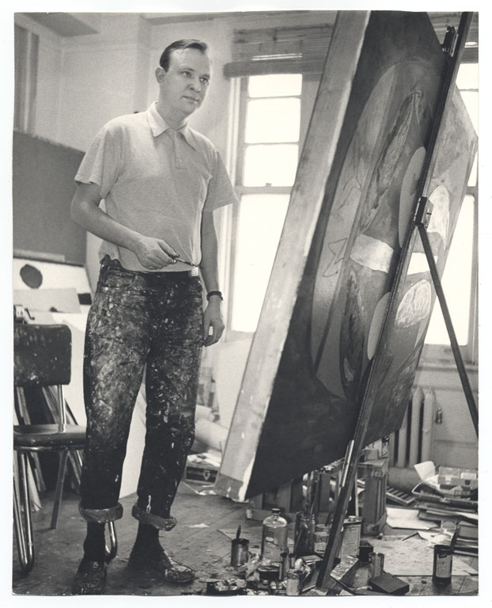
Robert Motherwell
(American, 1915-1991)

Slide 2
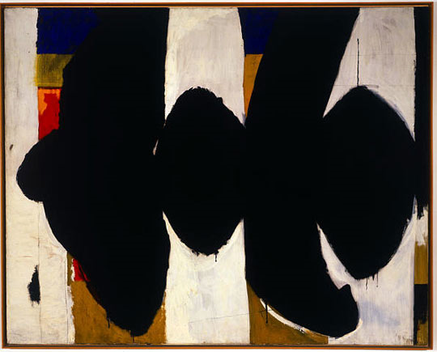
Robert Motherwell Elegy to the Spanish Republic #34
1953-54 Oil on canvas

Slide 3
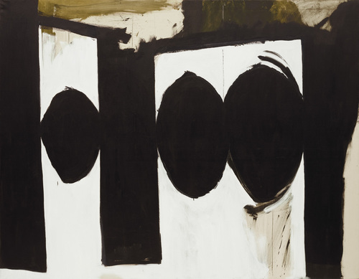
Elegy to the Spanish Republic, 54
Robert Motherwell
1957-61
Oil on canvas

Slide 4
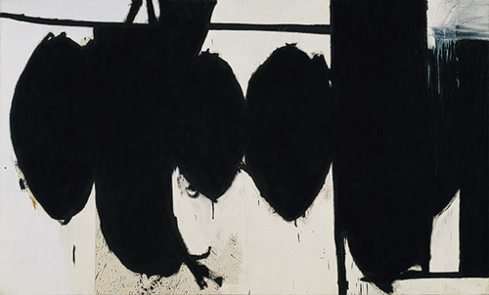
Robert Motherwell
Elegy to the Spanish Republic, 70
1961
Oil on canvas

Slide 5
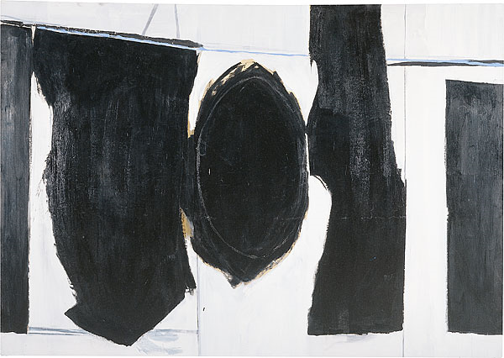
Elegy to the Spanish Republic 1958
Synthetic polymer paint on canvas

Slide 6
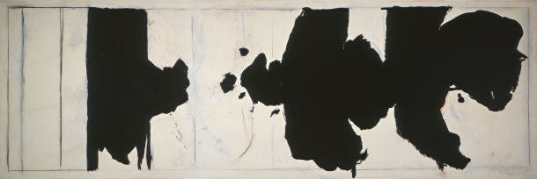
Robert Motherwell Reconciliation Elegy
1978

Slide 7
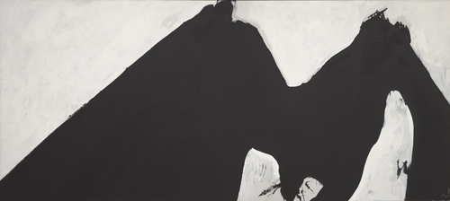
Robert Motherwell
In Black and White No. 2 (Africa)
1975
Synthetic polymer paint on canvas,

Slide 8
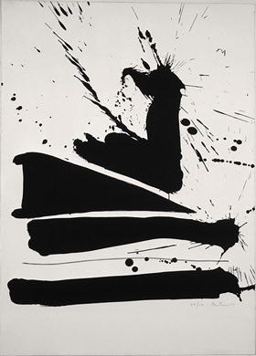
Robert Motherwell Automatism B
1965-1966

Slide 9
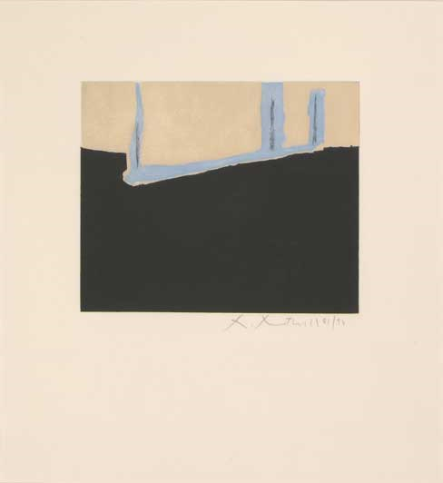
Robert Motherwell
Untitled

Slide 10
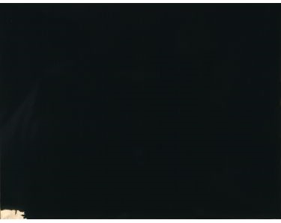
Robert Motherwell
Iberia
1958
Oil on canvas

Slide 11
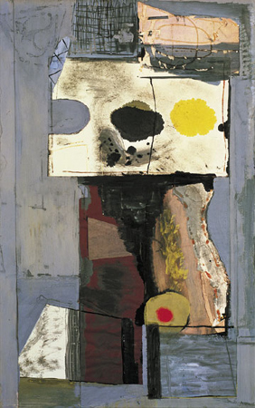
Robert Motherwell Personage (Autoportrait)
Paper collage, gouache, and ink on board

Slide 12
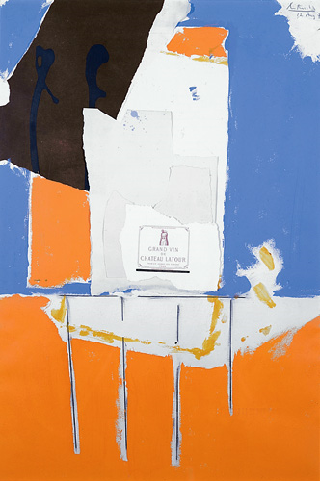
Summer Light Series: Pauillac, #1, 1973
Lithograph, collage, embossing

Slide 13
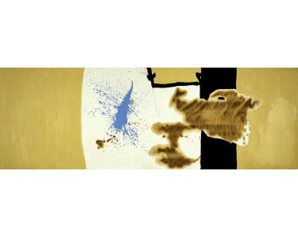
Robert Motherwell
The Voyage: Ten Years After
1961
Acrylic on canvas

Slide 14
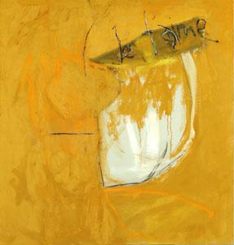
Robert Motherwell
Je T’aime No. VIII (Mallarmé’s Swan:Homage)
1957 Oil on linen

Slide 15
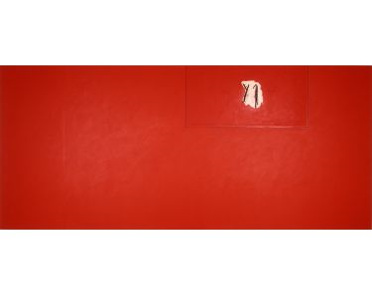
Robert Motherwell
Phoenician Red Studio
1977
Acrylic and charcoal on canvas

